Slide 1
Bray Team Week 7 Update
Avery Haynes, Locke Lehmann, Travis Carlson, Cody Sims, Zachary Walker, Michael Hager
10/2/2023

Slide 2
Week 6 Deliverables
Week 6 Tasks
Deliverable | Team Member | Percent Completed | Notes
Organize Brainstorming and narrow ideas | Avery | 80% | Bray provided feedback on brainstorming ideas and criteria metrics, need to further reduce ideas
Brainstorm more ideas | Locke | 75%
look over DR1 reports | Zack | 80%
function stage 2/3 | Cody | 20%
function stage 4/5 | Michael | 20%
continue revising DR! | All | 80%

Slide 3
Week 7 Plans
Week 7 Tasks
Deliverable | Team Member | Percent Completed | Notes
Narrow in on concept selection | All | 20%
Organize and prioritize metrics | Locke | 20% | Need to talk with Bray about what's most important
Remainder of function chain | Cody/Travis | 20%
Work Breakdown Structure/Gantt Chart | Michael | 20% | Began, need to organize future steps and plan
Finish and submit revised DR1 reports | All | 80%
Analyze SolidWorks models of valves | Zack | 40%
Use class techniques for brainstorming & evaluating concepts | Avery | 0%
Gantt Chart & Project Management Software | All | 0%

Slide 4
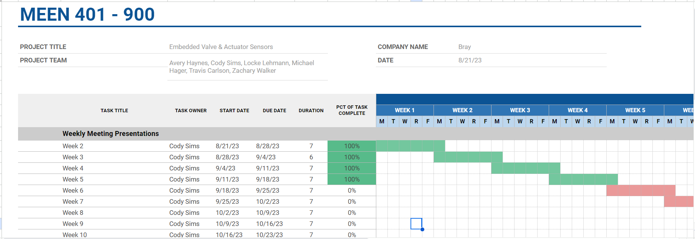
Beginning of Gantt Chart

Slide 5
Week 7 Issues/Needs
Look at SolidWorks models to understand valves better
Talk with Bray about which solution they’d like to prioritize
Finish revising customer needs and DR1 reports and submit

